Slide 1
Unit 8
Graph Using Intercepts, Slope-Intercept, and Point-Slope Form
Integrated mathematics 9

Slide 2
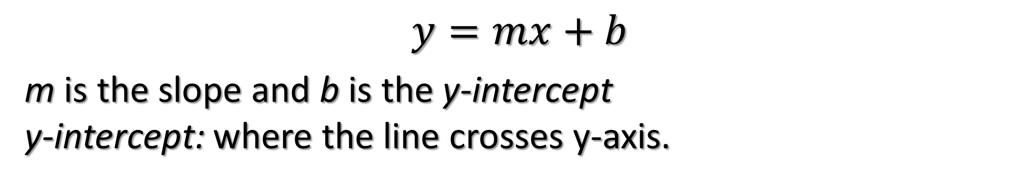
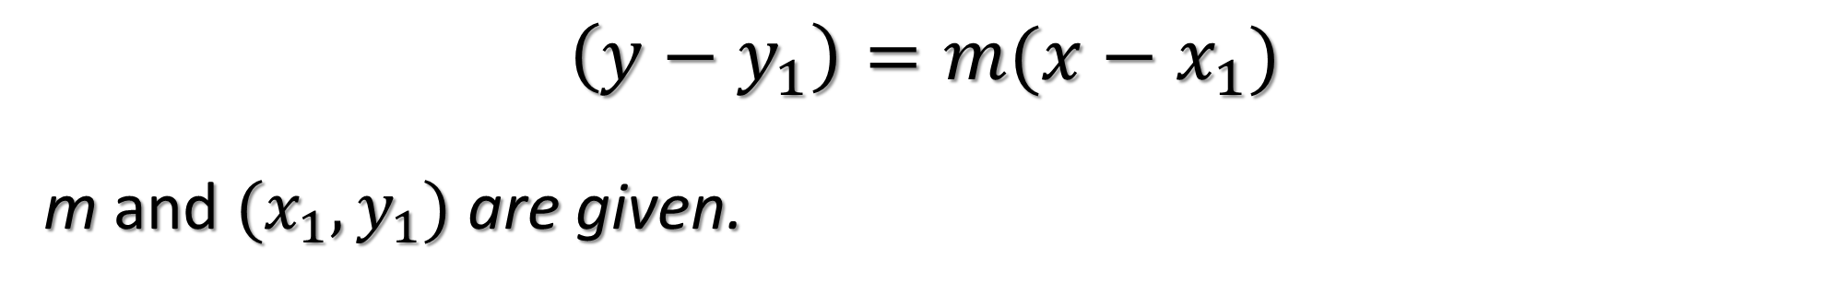
Point-Slope Form
$$\left(y−y_{1}\right)=m(x−x_{1})$$
m and $(x_{1},y_{1})$ are given.
Slope-Intercept Form
$$y=mx+b$$
m is the slope and b is the y-intercept
y-intercept: where the line crosses y-axis.

Slide 3
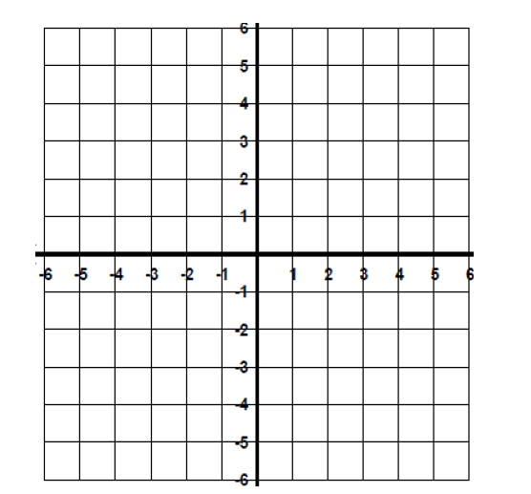
Graph the Equations using y = mx + b
$$y=2x−3$$

Slide 4
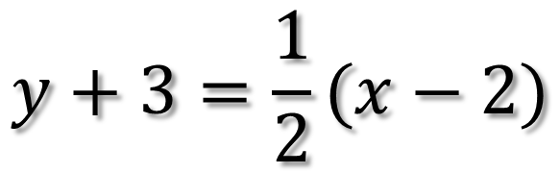
Graph the Equations using y = mx + b
$$y+3=\frac{1}{2}(x−2)$$

Slide 5
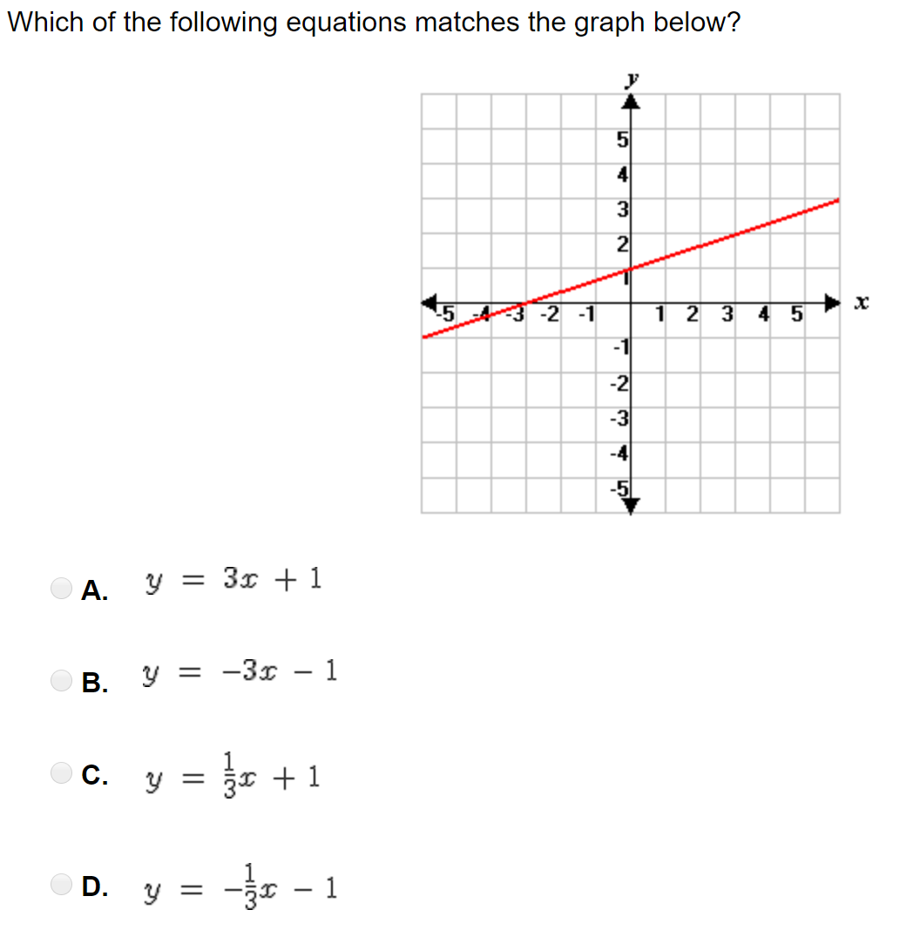
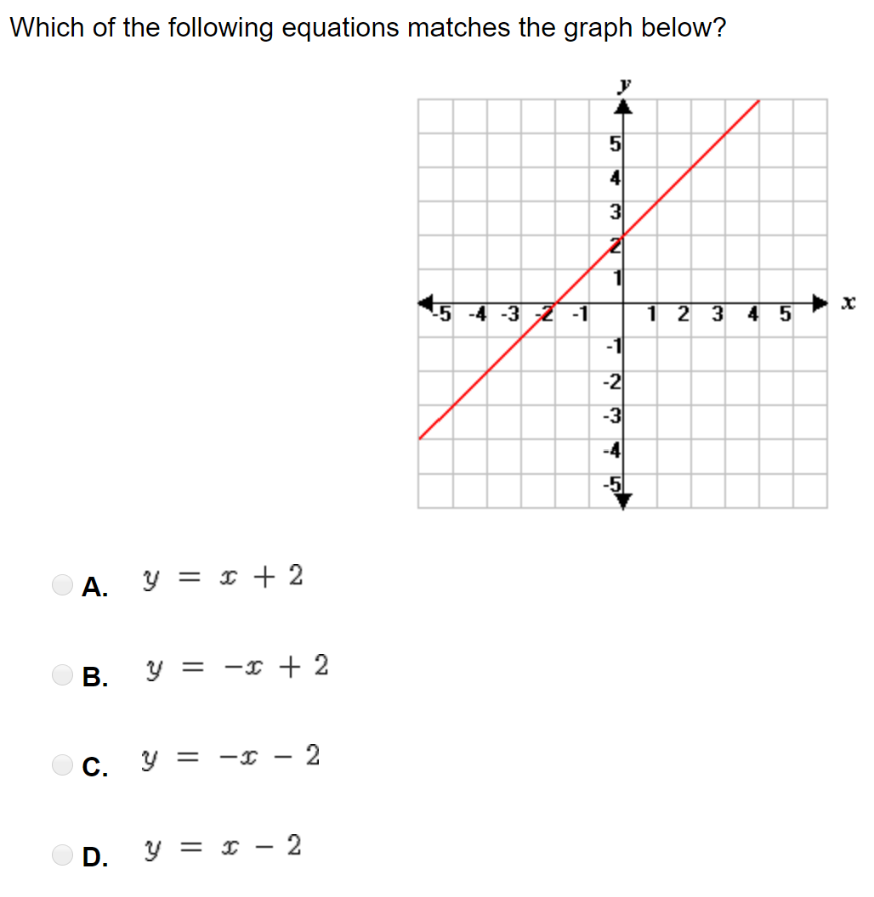

Slide 6
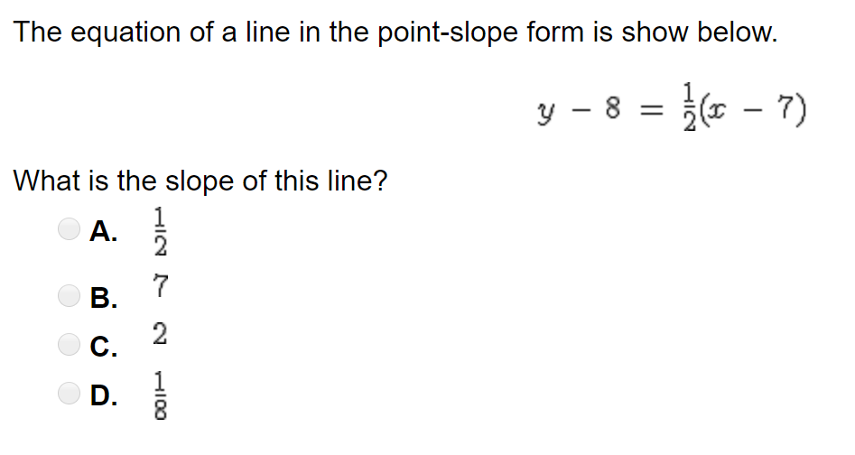
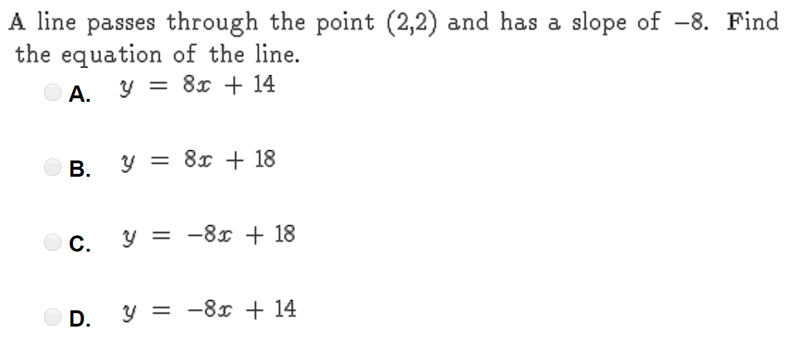

Slide 7
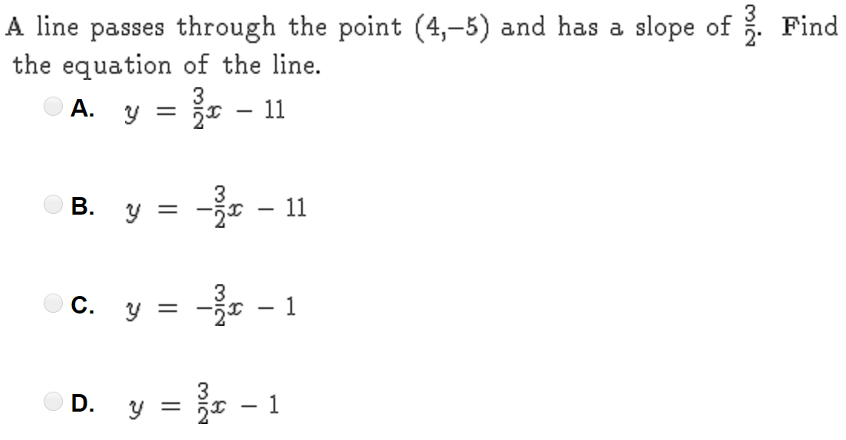
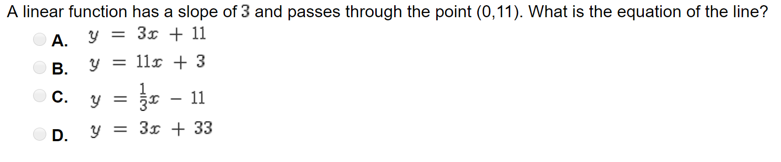

Slide 8
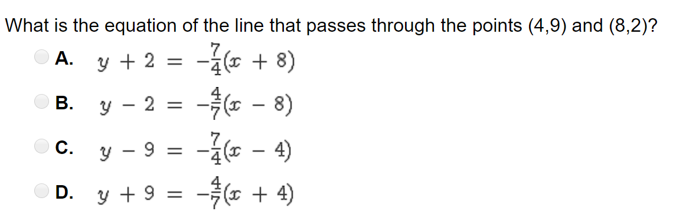
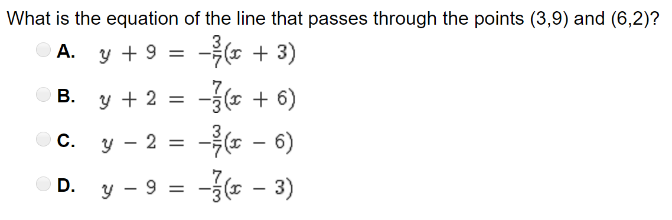

Slide 9
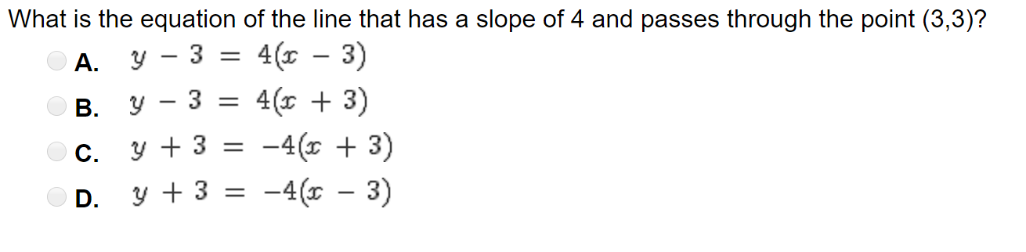

Slide 10


y = # the graph is horizontal x = # the graph is vertical
$$x=5$$
$$y=−8$$

